Slide 1
Huggies DRD
February 2023

Slide 2
Spend Summary by Platform
Total Spends for Active Baby and Newborn |  |  | Spends Contribution
Media Tactic Spends (ZAR) | MAT 21 | MAT 22 | MAT 21 | MAT 22
TV_Spends | 15,842,565 | 20,128,965 | 63% | 72%
FB_IG_Spends | 3,334,265 | 4,366,704 | 13% | 16%
Video_Spends | 2,124,610 | 572,761 | 8% | 2%
Display_Spends | 2,102,233 | 1,356,261 | 8% | 5%
Search_Spends | 1,868,950 | 1,356,261 | 7% | 5%
Total | 25,272,623 | 27,780,952 | 100% | 100%
Source: KCC Media data
Note: MAT 21- Oct 2020 to Sept 2021, MAT 22- Oct 2021 to Sept 2022

Slide 3
Spend chart for Active Baby, Newborn and Extra Care.
 | Active Baby |  | Newborn |  | Extra Care |  | Total Spends for Active Baby and Newborn
Media Tactic Spends (ZAR) | MAT 21 | MAT 22 | MAT 21 | MAT 22 | MAT 21 | MAT 22 | MAT 21 | MAT 22
TV | 5,099,078 | 14,596,070 | 10,743,487 | 5,532,895 | 1,592,638 | 6,883,623 | 15,842,565 | 20,128,965
FB & IG | 1,903,301 | 2,215,587 | 1,430,964 | 2,151,116 | - | 1,951,116 | 3,334,265 | 4,366,704
Video | 853,223 | 303,059 | 1,271,387 | 269,702 | - | 269,702 | 2,124,610 | 572,761
Display | 850,878 | 692,064 | 1,018,072 | 664,197 | 423,207 | 663,835 | 2,102,233 | 1,356,261
Search | 835,604 | 692,064 | 1,266,629 | 664,197 | 423,207 | 663,835 | 1,868,950 | 1,356,261
OOH | - | - | 232,799 | - | - | - | 232,799 | -
Print | - | - | 132,563 | - | - | - | 132,563 | -
Total | 9,542,085 | 18,498,844 | 16,095,901 | 9,282,107 | 2,439,052 | 10,432,111 | 25,637,985 | 27,780,951
Note:-OOH is for Total Huggies, Print spends for NB

Slide 4
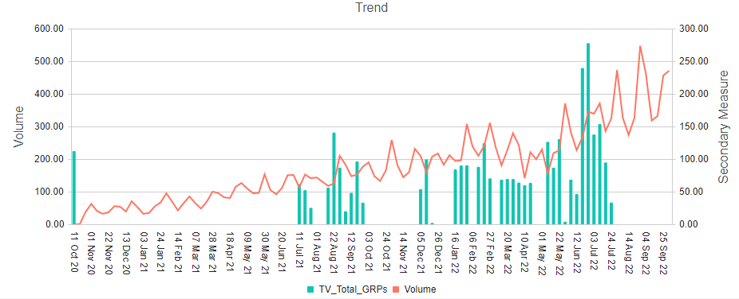
Active Baby - TV GRP’s vs Volume
MAT 22 shows an increase in GRPs and Spends as compared to MAT 21
GRPs
Platform | GRPs |  | Spends(ZAR) |  | CPP
 | MAT 21 | MAT 22 | MAT 21 | MAT 22 | MAT 21 | MAT 22
TV | 725 | 2,478 | 5,099,078 | 14,596,070 | 7,034 | 5,890
+242%
+186
-16%
Source: KCC Media data
Note: MAT 21- Oct 2020 to Sept 2021, MAT 22- Oct 2021 to Sept 2022
Powered by Analytic-edge

Slide 5
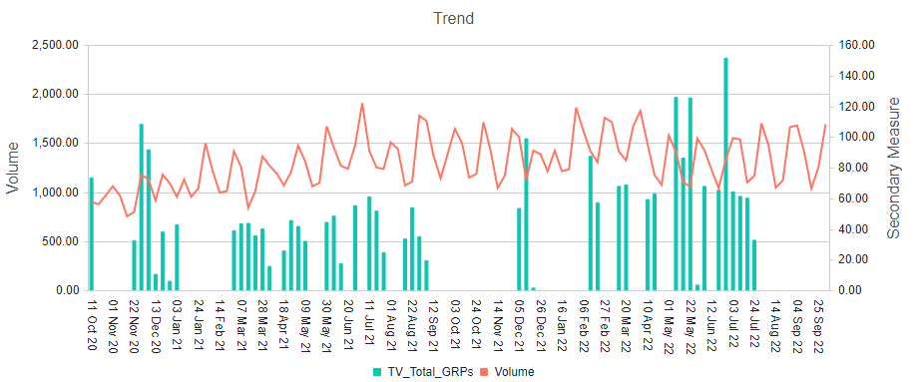
New Born - TV GRPs vs Volume
Sparse execution over the time period
GRPs
Platform | GRP’s |  | Spends(ZAR) |  | CPP
 | MAT 21 | MAT 22 | MAT 21 | MAT 22 | MAT 21 | MAT 22
TV | 1,206 | 1,399 | 10,743,487 | 5,532,895 | 8,905 | 3,956
+16%
-49%
-56%
Source: KCC Media data
Note: MAT 21- Oct 2020 to Sept 2021, MAT 22- Oct 2021 to Sept 2022
Powered by Analytic-edge

Slide 6
Extra Care - TV GRPs vs Volume
Spending on TV has increased significantly in MAT 22
Platform | GRP’s |  | Spends(ZAR) |  | CPP
 | MAT 21 | MAT 22 | MAT 21 | MAT 22 | MAT 21 | MAT 22
TV | 1,677 | - | 1,592,638 | 6,883,623 | 950 | -
+332%
Source: KCC Media data
Note: MAT 21- Oct 2020 to Sept 2021, MAT 22- Oct 2021 to Sept 2022
Powered by Analytic-edge

Slide 7
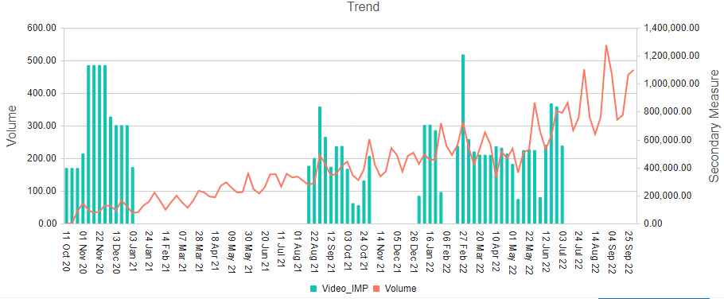
Active Baby - Video Impressions vs Volume
MAT 22 executions were maintained despite a 64% decrease in Video spending.
IMPs
Platform | Impressions |  | Spends(ZAR) |  | CPM
 | MAT 21 | MAT 22 | MAT 21 | MAT 22 | MAT 21 | MAT 22
Video | 13,682,830 | 14,626,188 | 853,223 | 303,059 | 62,357 | 20,720
+7%
-64%
-67%
Source: KCC Media data
Note: MAT 21- Oct 2020 to Sept 2021, MAT 22- Oct 2021 to Sept 2022, CPM – Cost/MM Imps
Powered by Analytic-edge

Slide 8
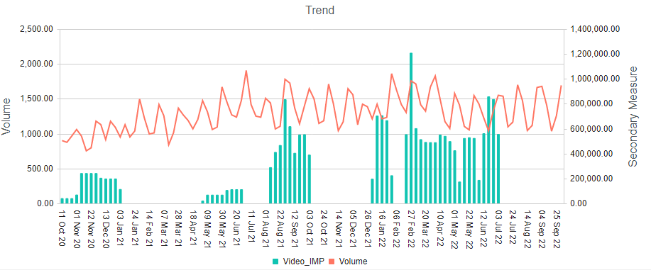
Newborn Baby - Video Impressions vs Volume
MAT 22 executions were increased despite a 79% decrease in their spending.
IMPs
Platform | Impressions |  | Spends(ZAR) |  | CPM
 | MAT 21 | MAT 22 | MAT 21 | MAT 22 | MAT 21 | MAT 22
Video | 7,281,454 | 13,571,558 | 1,271,387 | 269,702 | 174,606 | 19,873
+86%
-79%
-89%
Source: KCC Media data
Note: MAT 21- Oct 2020 to Sept 2021, MAT 22- Oct 2021 to Sept 2022, CPM – Cost/MM Imps
Powered by Analytic-edge

Slide 9
Extra Care - Video Imps
Extra care video execution only during MAT 22
Platform | Impressions |  | Spends(ZAR) |  | CPP
 | MAT 21 | MAT 22 | MAT 21 | MAT 22 | MAT 21 | MAT 22
Video | - | 13,571,558 | - | 269,702 | - | 19,873
Source: KCC Media data
Note: MAT 21- Oct 2020 to Sept 2021, MAT 22- Oct 2021 to Sept 2022
Powered by Analytic-edge

Slide 10
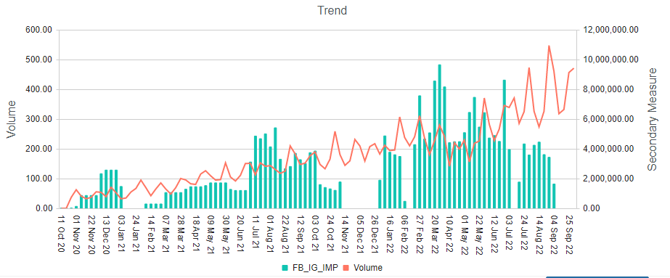
Active Baby - FB (Paid Social) Impressions vs Volume
Facebook execution has increased significantly in MAT 22
IMPs
Platform | Impressions |  | Spends(ZAR) |  | CPM
 | MAT 21 | MAT 22 | MAT 21 | MAT 22 | MAT 21 | MAT 22
FB | 92,987,850 | 171,279,612 | 1,903,301 | 2,215,587 | 20,468 | 12,936
+84%
+16%
-37%
Source: KCC Media data
Note: MAT 21- Oct 2020 to Sept 2021, MAT 22- Oct 2021 to Sept 2022, CPM – Cost/MM Imps
Powered by Analytic-edge

Slide 11
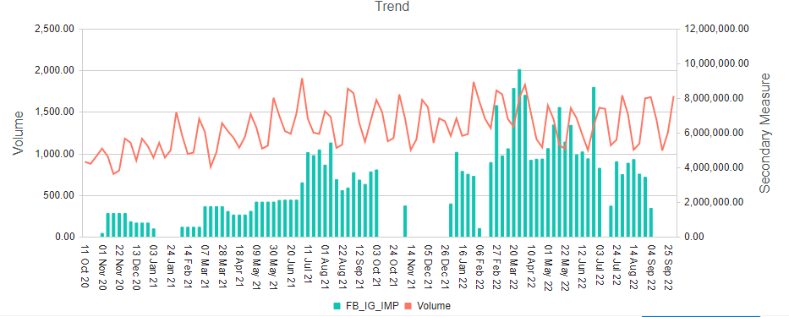
New Born Baby - FB (Paid Social) Impressions vs Volume
Sparse executions over the time period
IMPs
Platform | Impressions |  | Spends(ZAR) |  | CPM
 | MAT 21 | MAT 22 | MAT 21 | MAT 22 | MAT 21 | MAT 22
FB | 94,999,639 | 165,766,653 | 1,430,964 | 2,151,116 | 15,063 | 12,977
+74%
+50%
-14%
Source: KCC Media data
Note: MAT 21- Oct 2020 to Sept 2021, MAT 22- Oct 2021 to Sept 2022, CPM – Cost/MM Imps
Powered by Analytic-edge

Slide 12
Extra Care – FB (Paid Social) Imps
FB(Paid social) executed only during MAT 22 time period
Platform | Impressions |  | Spends(ZAR) |  | CPM
 | MAT 21 | MAT 22 | MAT 21 | MAT 22 | MAT 21 | MAT 22
FB | - | 138,722,078 | - | 1,951,116 | - | 14,065
Source: KCC Media data
Note: MAT 21- Oct 2020 to Sept 2021, MAT 22- Oct 2021 to Sept 2022
Powered by Analytic-edge

Slide 13
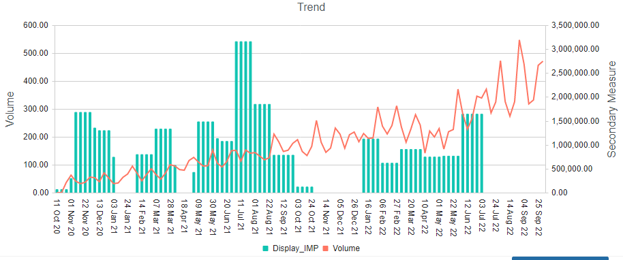
Active Baby - Display Impressions vs Volume
Executions have been decreased by 54% in MAT 22.
IMPs
Platform | Impressions |  | Spends(ZAR) |  | CPM
 | MAT 21 | MAT 22 | MAT 21 | MAT 22 | MAT 21 | MAT 22
Display | 56,959,768 | 26,039,115 | 850,878 | 692,064 | 14,938 | 26,578
-54%
-19%
+78%
Source: KCC Media data
Note: MAT 21- Oct 2020 to Sept 2021, MAT 22- Oct 2021 to Sept 2022
CPM is Cost / MM IMPs
Powered by Analytic-edge

Slide 14
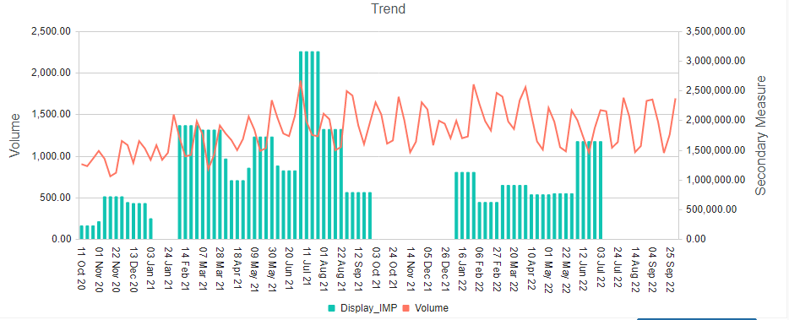
New Born – Display Impressions vs Volume
Sparse execution over the time period
IMPs
Platform | Impressions |  | Spends(ZAR) |  | CPM
 | MAT 21 | MAT 22 | MAT 21 | MAT 22 | MAT 21 | MAT 22
Display | 62,479,345 | 25,686,699 | 1,018,072 | 664,197 | 16,295 | 25,858
-59%
-35%
+59%
Source: KCC Media data
Note: MAT 21- Oct 2020 to Sept 2021, MAT 22- Oct 2021 to Sept 2022
Powered by Analytic-edge

Slide 15
Extra Care – Display Imps
There is 57% increase in spending in MAT 22 compared to MAT 21
Platform | Impressions |  | Spends(ZAR) |  | CPM
 | MAT 21 | MAT 22 | MAT 21 | MAT 22 | MAT 21 | MAT 22
Display | 23,918,539 | 25,686,461 | 423,207 | 663,835 | 17,694 | 25,844
+7%
+57%
+46%
Source: KCC Media data
Note: MAT 21- Oct 2020 to Sept 2021, MAT 22- Oct 2021 to Sept 2022
Powered by Analytic-edge

Slide 16
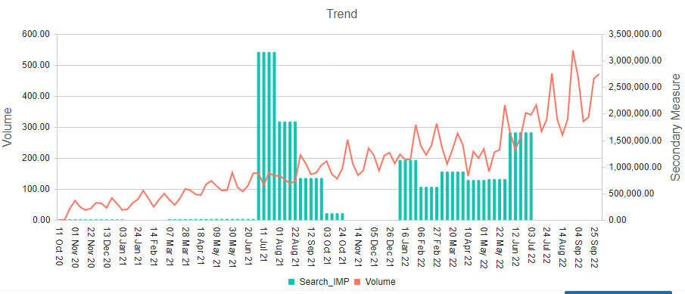
Active Baby - Search Impressions vs Volume
Despite a decrease in spending, Search impressions increased in MAT 22 by 8%
IMPs
Platform | Impressions |  | Spends(ZAR) |  | CPM
 | MAT 21 | MAT 22 | MAT 21 | MAT 22 | MAT 21 | MAT 22
Search | 24,221,121 | 26,039,115 | 835,604 | 692,064 | 34,499 | 26,578
+8%
-17%
-23%
Source: KCC Media data
Note: MAT 21- Oct 2020 to Sept 2021, MAT 22- Oct 2021 to Sept 2022, CPM – Cost/MM Imps
Powered by Analytic-edge

Slide 17
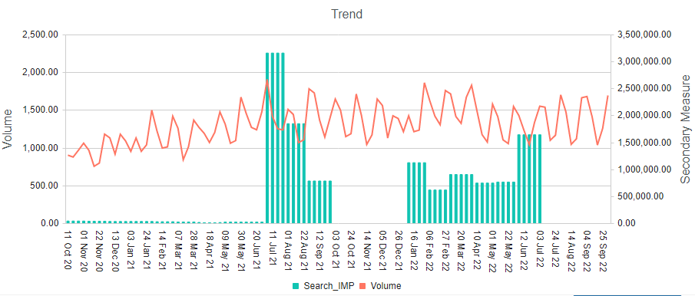
New Born- Search Impressions vs Volume
MAT 22 executions were maintained despite a 48% decrease in search spending.
IMPs
Platform | Impressions |  | Spends(ZAR) |  | CPM
 | MAT 21 | MAT 22 | MAT 21 | MAT 22 | MAT 21 | MAT 22
Search | 24,910,583 | 25,686,699 | 1,266,629 | 664,197 | 50,847 | 25,858
+3%
-48%
-49%
Source: KCC Media data
Note: MAT 21- Oct 2020 to Sept 2021, MAT 22- Oct 2021 to Sept 2022, CPM – Cost/MM Imps
Powered by Analytic-edge

Slide 18
Extra Care – Search Imps
For extra care, Search executions have increased in MAT 22 by 57%
Platform | Impressions |  | Spends(ZAR) |  | CPM
 | MAT 21 | MAT 22 | MAT 21 | MAT 22 | MAT 21 | MAT 22
Search | 23,918,539 | 25,686,461 | 423,207 | 663,835 | 17,694 | 25,844
+7%
+57%
+46%
Source: KCC Media data
Note: MAT 21- Oct 2020 to Sept 2021, MAT 22- Oct 2021 to Sept 2022
Powered by Analytic-edge

Slide 19
Total Huggies
Powered by Analytic-edge

Slide 20
Total Huggies- Website Sessions
Platform | Impressions
 | MAT 21 | MAT 22
Website Sessions | 599,267 | 594,727
-1%
Source: KCC Media data
Note: MAT 21- Oct 2020 to Sept 2021, MAT 22- Oct 2021 to Sept 2022
Powered by Analytic-edge

Slide 21
Total Huggies- Organic Search
Platform | Impressions
 | MAT 21 | MAT 22
Organic Search | 8,951,021 | 281,440
-97%
Source: KCC Media data
Note: MAT 21- Oct 2020 to Sept 2021, MAT 22- Oct 2021 to Sept 2022
Powered by Analytic-edge

Slide 22
Total Huggies- Organic Social
Platform | Impressions
 | MAT 21 | MAT 22
Organic Social | 1,210,427 | 593,724
-51%
Source: KCC Media data
Note: MAT 21- Oct 2020 to Sept 2021, MAT 22- Oct 2021 to Sept 2022
Powered by Analytic-edge

Slide 23
Total Huggies- Emails
Platform | Emails
 | MAT 21 | MAT 22
Emails send | 112,420 | 125,058
+11%
Source: KCC Media data
Note: MAT 21- Oct 2020 to Sept 2021, MAT 22- Oct 2021 to Sept 2022
Powered by Analytic-edge

Slide 24
Powered by Analytic-edge

